Slide 1

Fraud Detection Sentiment Analysis System
Under The Guidance Of
Dr. Mukesh Choudhary
Developed By
Ishika Gupta (2305102110003)
Vishwa Thakkar (2305102120017)
Ninad Patel (2305102120010)
Submitted To:
Department of MCA & M. Sc. (IT)
Faculty of IT & Computer Science,
PARUL University

Slide 2
1. Project Profile
The FD-SAS project seeks to create a cutting-edge system that leverages the power of sentiment analysis to identify and prevent fraudulent activities. By harnessing the potential of natural language processing (NLP) and machine learning algorithms, the system will scrutinize customer feedback and reviews to detect subtle patterns and anomalies that may indicate malicious behavior.
The primary objective of the FD-SAS project is to develop a robust and efficient system that empowers organizations to proactively detect and prevent fraudulent activities, thereby minimizing financial losses and fostering customer trust. To achieve this goal, the system will be designed to analyses customer feedback from a variety of sources, including social media platforms, online review sites, and customer surveys.

Slide 3
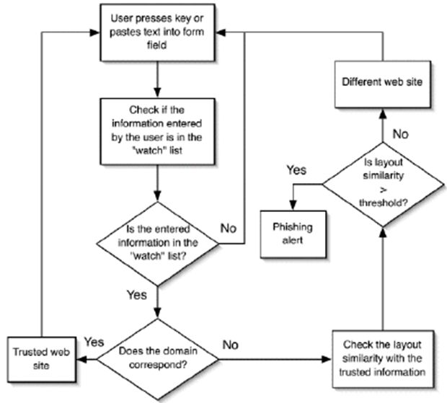
2. Objectives
Develop a robust machine learning model to detect fraudulent websites.
Create a user-friendly interface for users to report suspicious sites.
Enhance existing cybersecurity measures by integrating real-time detection.
Raise awareness about online threats through educational resources.
Diagram 1 : Proposed System

Slide 4
3. Existing System Vs. Proposed System
SAS Sentiment Analysis : This system uses machine learning algorithms to analyses customer feedback and detect sentiment patterns that may indicate fraudulent behavior.
IBM Watson Natural Language Understanding : This system uses NLP and machine learning algorithms to analyses customer feedback and detect sentiment patterns that may indicate fraudulent behavior.
Improve Accuracy : The new system should be able to improve the accuracy of fraud detection by using advanced machine learning algorithms and NLP techniques.
Reduce False Positive Rate : The new system should be able to reduce the false positive rate by using advanced filtering and validation techniques.

Slide 5
3. Existing System Vs. Proposed System
Manual Review Process : Many organizations use manual review processes to detect fraudulent activities, which can be time-consuming and prone to errors.
Improve Efficiency : The new system should be able to improve the efficiency of fraud detection by automating the review process and providing real-time alerts and notifications.

Slide 6
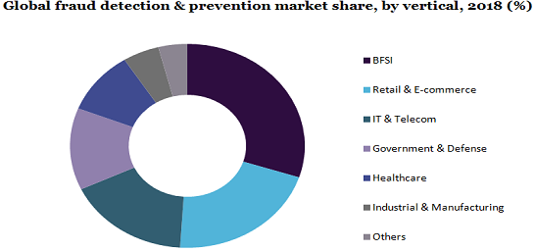
4. Scope
Financial Services: The system can be used by banks and financial institutions to detect and prevent financial crimes, such as money laundering and credit card fraud.
E-commerce: The system can be used by e-commerce companies to detect and prevent online fraud, such as identity theft and phishing.
Diagram 2 : Scope of Project

Slide 7
5. Project Plan
Phase 1: Requirements Gathering and Analysis
Identify data sources.
Extract and load data into a central repository (e.g. database). Phase 2: Design
Phase 2 : Design
Split data into training and validation sets.
Train and evaluate the model’s performance.
Phase 3 : Development
Build the user interface using HTML, CSS, and JavaScript.
Develop the server-side logic using Python or Node.js
Connect the application to the chosen database.

Slide 8
5. Project Plan
Phase 4 : Testing
Unit Testing : Test individual components (e.g. ML algorithms).
Integration Testing: Ensure the system works as a whole (e.g., from data upload to fraud detection report generation).
Performance Testing: Test the system for performance under heavy loads, focusing on data processing speed and latency.
Phase 5 : Deployment
Set up the deployment environment (e.g., cloud platform, local server).
Deploy the application to the chosen environment.
Configure necessary settings and dependencies

Slide 9
6. Requirement Analysis
The system shall analyze customer reviews and feedback to detect potential fraudulent activities by identifying negative sentiments and anomalies in the data.
The system shall use machine learning algorithms to classify sentiments as positive, negative, or neutral and flag suspicious patterns for further investigation.
The system shall provide a user-friendly dashboard for administrators to monitor and analyze the results, enabling prompt action against potential fraudsters.
The system shall further add features like User authentication, authorization, and access control at the later stages of the development.

Slide 10
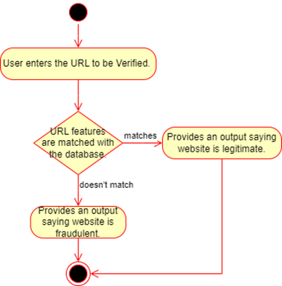
7. Design
The system will also provide real-time alerts and notifications to administrators, enabling them to take swift action to prevent potential fraud.
The FD-SAS system will feature a user-friendly interface that allows administrators to easily monitor and manage the system.
Diagram 3 : Design of Project

Slide 11
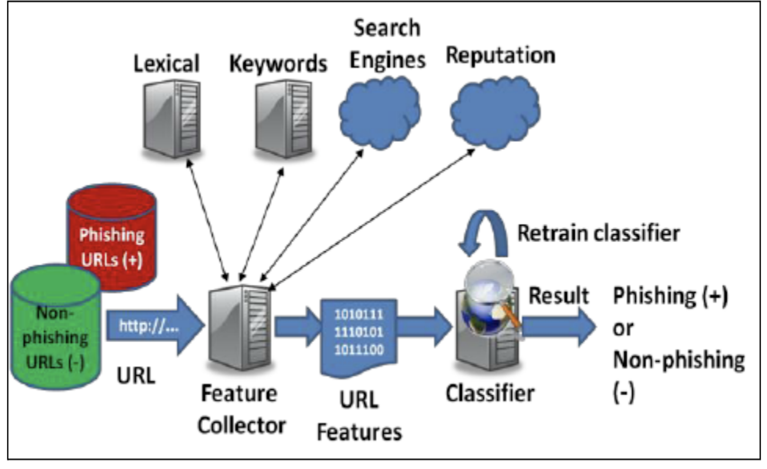
7. Design

Slide 12
8. Implementation
Data Collection: Utilize APIs from social media and review platforms to gather diverse customer feedback and reviews for analysis.
Data Pre-processing: Clean and normalize the collected text data to ensure it is suitable for sentiment analysis, removing noise and irrelevant information.
Sentiment Analysis: Apply natural language processing (NLP) techniques to classify sentiments (positive, negative, neutral) and identify anomalies that may suggest fraudulent activity.
Model Training and Visualization: Train machine learning models on the processed data to enhance detection accuracy, followed by the development of a dashboard for visualizing insights and enabling swift action against flagged fraud cases.

Slide 13
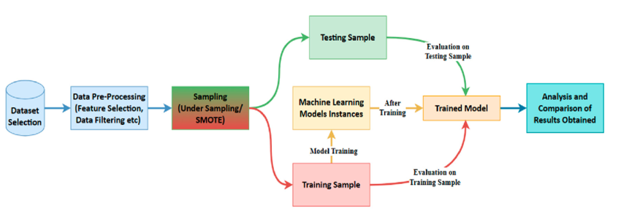
9. Feature Selection
A phishing website is a common social engineering method that mimics trustful uniform resource locators (URLs) and webpages.
The objective of this project is to train machine learning models and deep neural nets on the dataset created to predict phishing websites.
Both phishing and benign URLs of websites are gathered to form a dataset and from them required URL and website content-based features are extracted.
The performance level of each model is measures and compared.

Slide 14
10. Future Enhancements
Advanced Machine Learning Models : Incorporate state-of-the-art models like deep learning (e.g., LSTM, transformers) to improve sentiment classification accuracy and capture complex patterns in data.
Real-time Analysis : Implement real-time sentiment analysis to monitor social media and customer feedback continuously, allowing for immediate detection of potential fraud.
Integration with Other Data Sources : Combine sentiment analysis with other data sources (e.g., transaction data, user behaviour analytics) for a more holistic view of potential fraud indicators.
Improved Natural Language Processing Techniques : Utilize more sophisticated NLP techniques, such as contextual embeddings (e.g., BERT, GPT), to better understand nuances in language and improve sentiment detection.

Slide 15
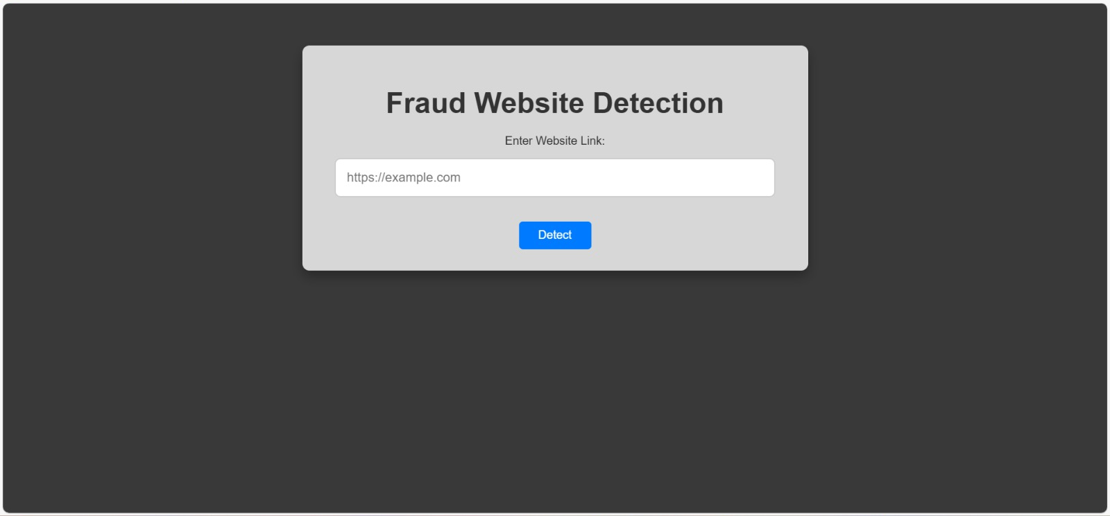
11. Website Demo
Step - 1

Slide 16
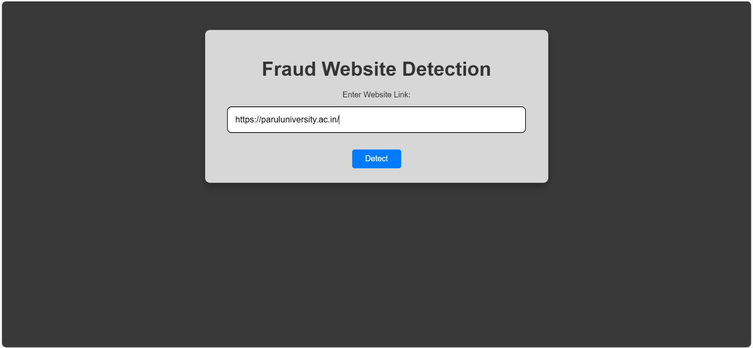
11. Website Demo
Step - 2

Slide 17
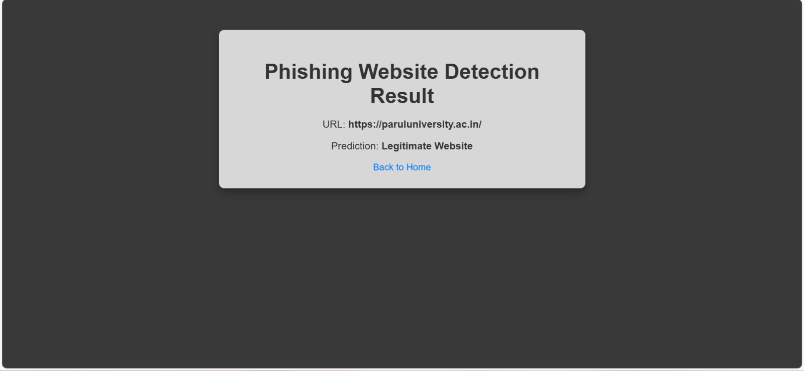
11. Website Demo
Step - 3

Slide 18
12. References
Academic Journals and Papers
"Sentiment Analysis for Fraud Detection in Online Reviews"
This paper discusses methodologies for applying sentiment analysis to online reviews to detect fraudulent activities. It explores various sentiment classification techniques and their effectiveness.
"Using Machine Learning for Fraud Detection: A Survey"
A comprehensive survey that covers various machine learning approaches, including sentiment analysis, for detecting fraud across different domains.
"Fraud Detection in Social Media: A Sentiment Analysis Approach"
This study investigates how sentiment analysis of social media content can be utilized to identify fraudulent behaviour and enhance detection mechanisms.

Slide 19
Thank You
A presentation by:
Ishika Gupta (2305102110003)
Vishwa Thakkar (2305102120017)
Ninad Patel (2305102120010)

